Slide 1
RxJS advanced

Slide 2
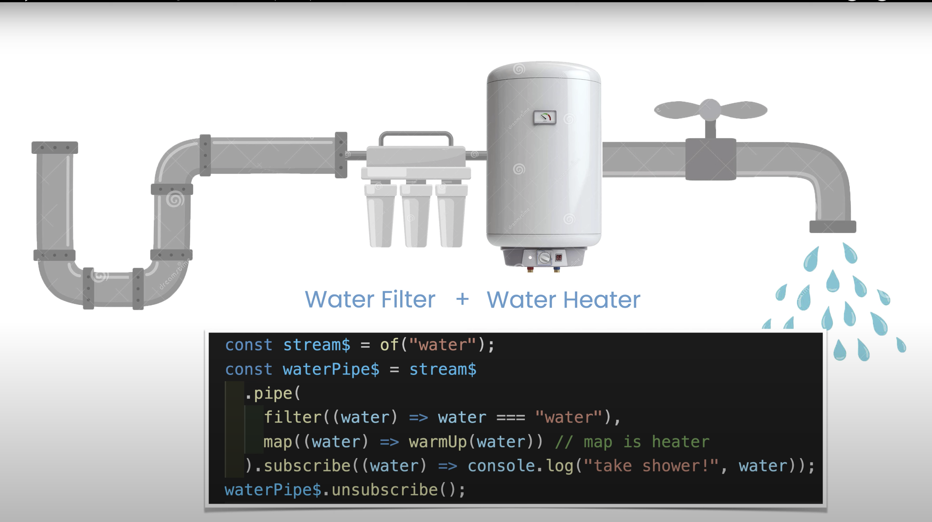
RxJS in Real live !
https://www.youtube.com/watch?v=xCfLfKNbnco&list=PLX7eV3JL9sfl8lRNZyzAu8YN-uqrgbhij

Slide 3
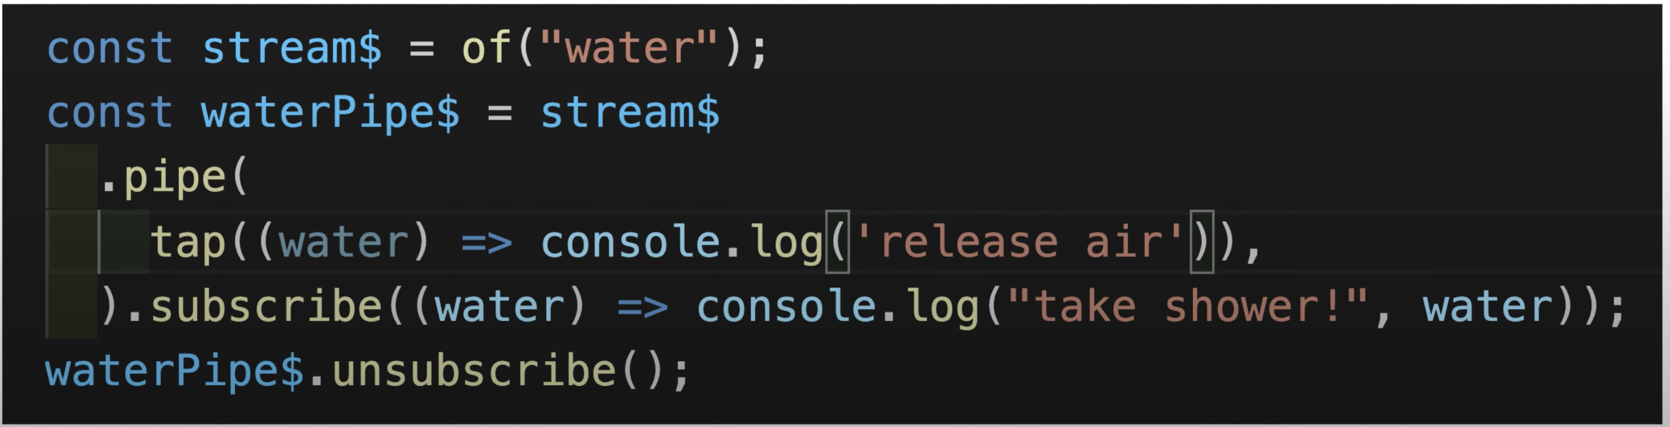
RxJs side effects – with tap-operator
DEMO: https://www.youtube.com/watch?v=xCfLfKNbnco&list=PLX7eV3JL9sfl8lRNZyzAu8YN-uqrgbhij

Slide 4
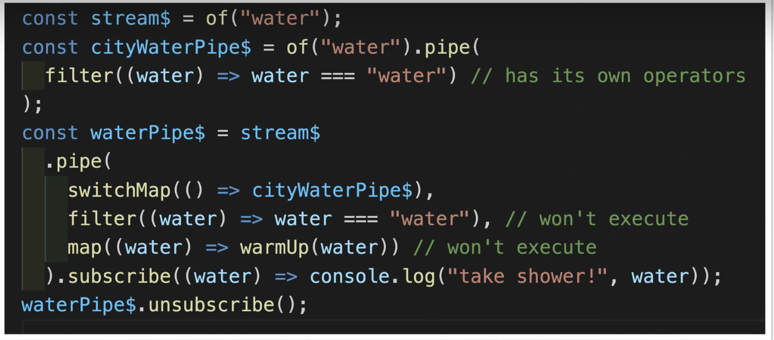
RxJs – switchMap – Real live
DEMO: https://www.youtube.com/watch?v=xCfLfKNbnco&list=PLX7eV3JL9sfl8lRNZyzAu8YN-uqrgbhij

Slide 5
Observers and Subscriptions
Observers are also called listeners (or consumers) as they can listen or subscribe to get the observed data.
Subscriptions are objects that are returned when you subscribe to an Observable. They contain many methods such as the unsubscribe() method that you can call to unsubscribe from receiving published values from the Observable.
From the official docs:
Subscription represents the execution of an Observable, is primarily useful for cancelling the execution.

Slide 6

RxJs zip-operator
https://www.youtube.com/watch?v=csRIMubWYnw&list=PLX7eV3JL9sfl8lRNZyzAu8YN-uqrgbhij&index=2

Slide 7

RxJs switchMap vs mergeMap
Flatmap = MergeMap !!!
https://www.youtube.com/watch?v=qYdKmYp95Jg

Slide 8
RxJs exhaustMap vs concatMap
https://www.youtube.com/watch?v=nh13_aPRQ0Q

Slide 9
concatMap, mergeMap, switchMap, exhaustMap, forkJoin
https://blog.angular-university.io/rxjs-higher-order-mapping/
How to choose the right mapping Operator?
If we need to do things in sequence while waiting for completion, then concatMap is the right choice
For doing things in parallel, mergeMap is the best option (flatMap is an alias for mergeMap!)
In case we need cancellation logic, switchMap is the way to go
For ignoring new Observables while the current one is still ongoing, exhaustMap does just that
forkJoin: Wait for Observables to complete and then combine last values they emitted.

Slide 10
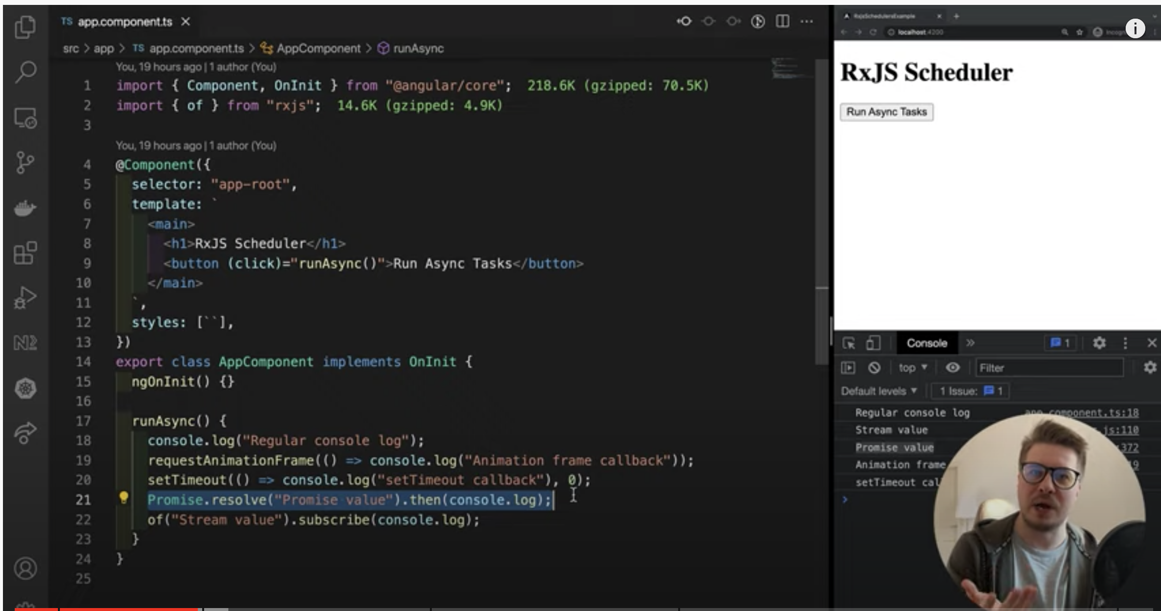
RxJs Schedulers
https://www.youtube.com/watch?v=-OhAR6l-Q0Q&list=PLX7eV3JL9sfl8lRNZyzAu8YN-uqrgbhij&index=5

Slide 11

Hot and Cold Observables
Unlike regular Observables, ‘Subjects’ are called hot.
A hot Observable starts emitting events even before any observer subscribes to it, which means observers may lose previous emitted values if they don’t subscribe at that right time
While cold Observables start emitting values when at least one observer is subscribed
See: https://www.youtube.com/watch?v=oKqcL-iMITY

Slide 12
Subject
Subject() = Observable and Observer

Slide 13
What is a Subject in RxJS?
A Subject is a special type of Observable that observers can also subscribe to it to receive published values but with one difference: The values are multicasted to many Observers.
Subjects are also Observers i.e they can also subscribe to other Observables and listen to published data.
By default an RxJS Observable is unicast.
Unicast simply means that each subscribed observer has an independent execution of the Observable,
while Multicast means that the Observable execution is shared by multiple Observers.

Slide 14
Use Subject
Notes:
A Subject is a special type of Observable that observers can also subscribe to it to receive published values but with one difference: The values are multicasted to many Observers.
Subjects are also Observers i.e they can also subscribe to other Observables and listen to published data.
By default an RxJS Observable is unicast.
Unicast simply means that each subscribed observer has an independent execution of the Observable while multicast means that the Observable execution is shared by multiple Observers.

Slide 15
Subject = Eventbus = queue/topic
Event
App
<component-1>
<component-4>
<component-2>
<component-3>
<component-5>
{{…}
}
{{…}
}
{{…}
}
See workshop-angular13: D03-pubsub-ordercomponent

Slide 16
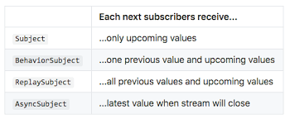
Subject vs BehaviorSubject vs ReplaySubject vs AsyncSubject
https://www.youtube.com/watch?v=sIeXs6EMKWQ

Slide 17
In depth RxJS Reference !!!
https://indepth.dev/reference/rxjs/operators
https://rxjs.dev/api/operators

